Slide 1

Innovative Partnering Challenge by Novo Nordisk

Slide 2
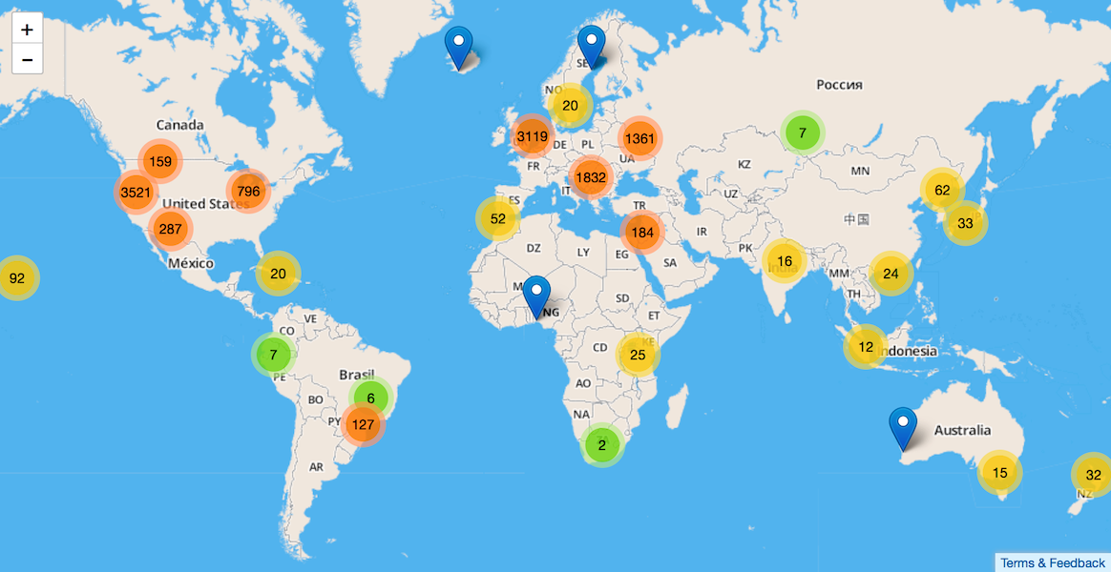
IDEAL SOLUTION
Company
B
Research
Center 1

Slide 3
IDEAL SOLUTION
Company
A
Company
B
University
1
Company
C
University
2
Research
Center 1

Slide 4
IDEAL SOLUTION
Person 1
Person 2
Person 3
STAFF
PRODUCTS
Product 1
Product 2
ACHIEVEMENTS
Prize 1
Publication 1
Company
A
Company
B
University
1
Company
C
University
2
Research
Center 1

Slide 5
PROBLEM
INPUT DATA
PROCESSING
OUTPUT
Up to date?
Relevant?
Duplicates
Incomplete data?
Structure data
Blending of data from different sources
Important parameters
Human error
Rankings
Hot spots
Reports
Notes:
We could have just take names and publications, but nothing new
what are of modern tech we could use to create new value

Slide 6
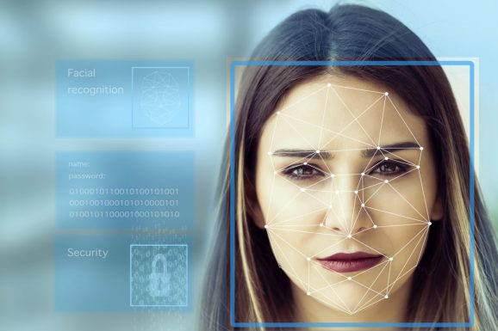
FACE RECOGNITION
Unique ID
Solves John Smith/ duplicates issue
Easier blending of data from
different sources
Identifing the attendance of key events

Slide 7



WHERE DO WE GET THE DATA FROM?
PUBLIC SOURCES
University webpages
Companies websites
PRIVATE, PAID DATABASES
Notes:
Before we staret with faces, we need a network . From here

Slide 8
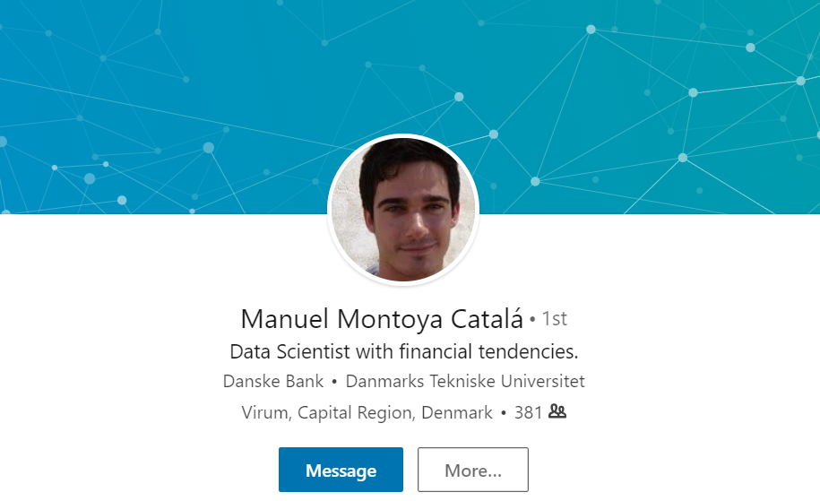
FACE
NAME
COMPANY
ADRESS

Slide 9
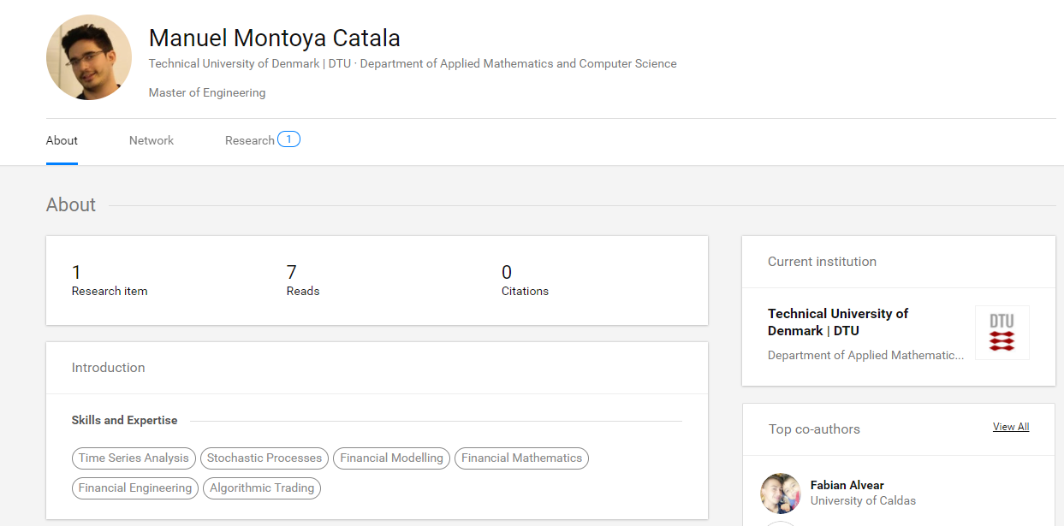
NAME
FACE
UNIVERSITY/COMPANY
SCORE
FIELD OF
INTEREST
PUBLICATIONS,
ABSTRACT

Slide 10









PRODUCT
CUSTOMER’S DATA
WEB APP

Slide 11
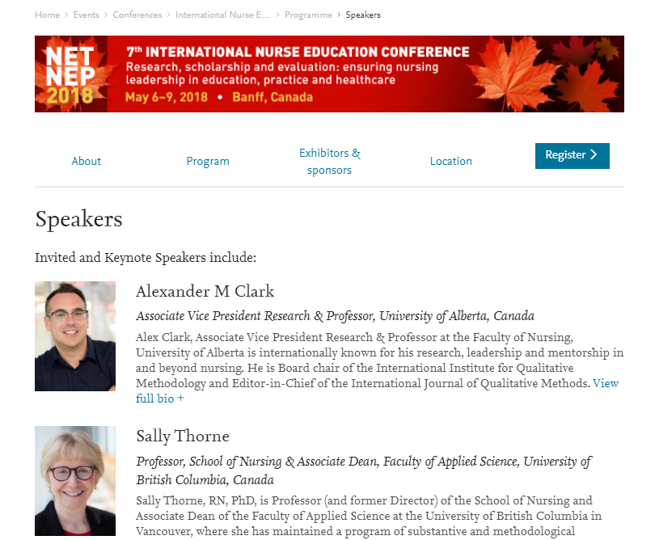
ENCHANCED CONFERENCES/MEETINGS
IS IT WORTH GOING THERE?
Alex Clark
BioCorp CEO
87% interesting
Sally Throne
UBC Proffessor
65% interesting

Slide 12

Pocket Advisor
KNOW WHO TO TALK TO
Anna Smith, Junior Researcher at DTU, 20% interesting
Mark Zones
BioCorp CEO
92% interesting
Zenna Smith
Head of Medical Dep. DTU
87% interesting

Slide 13
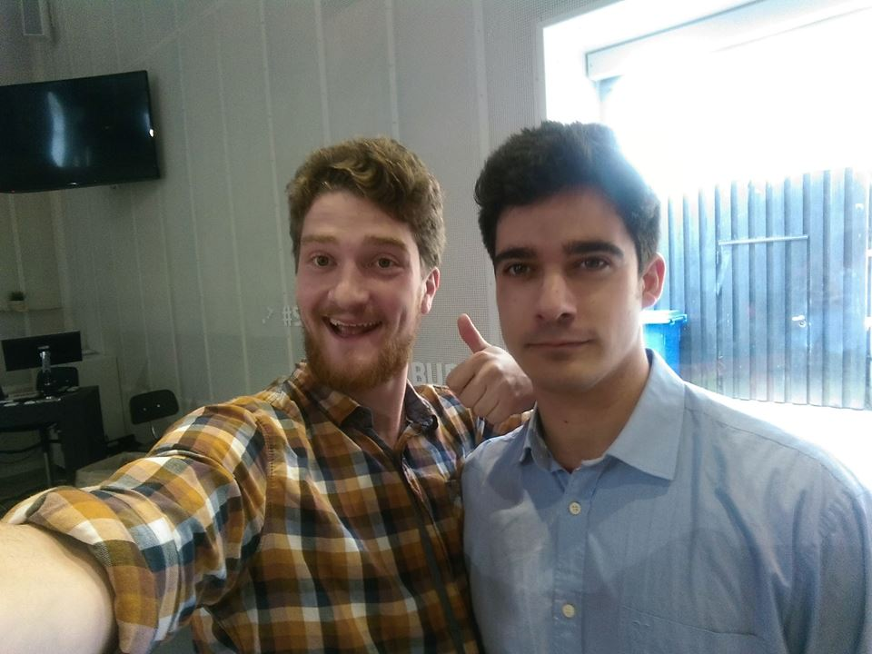
SELFIE TIME? SELFIE TIME!

Slide 14
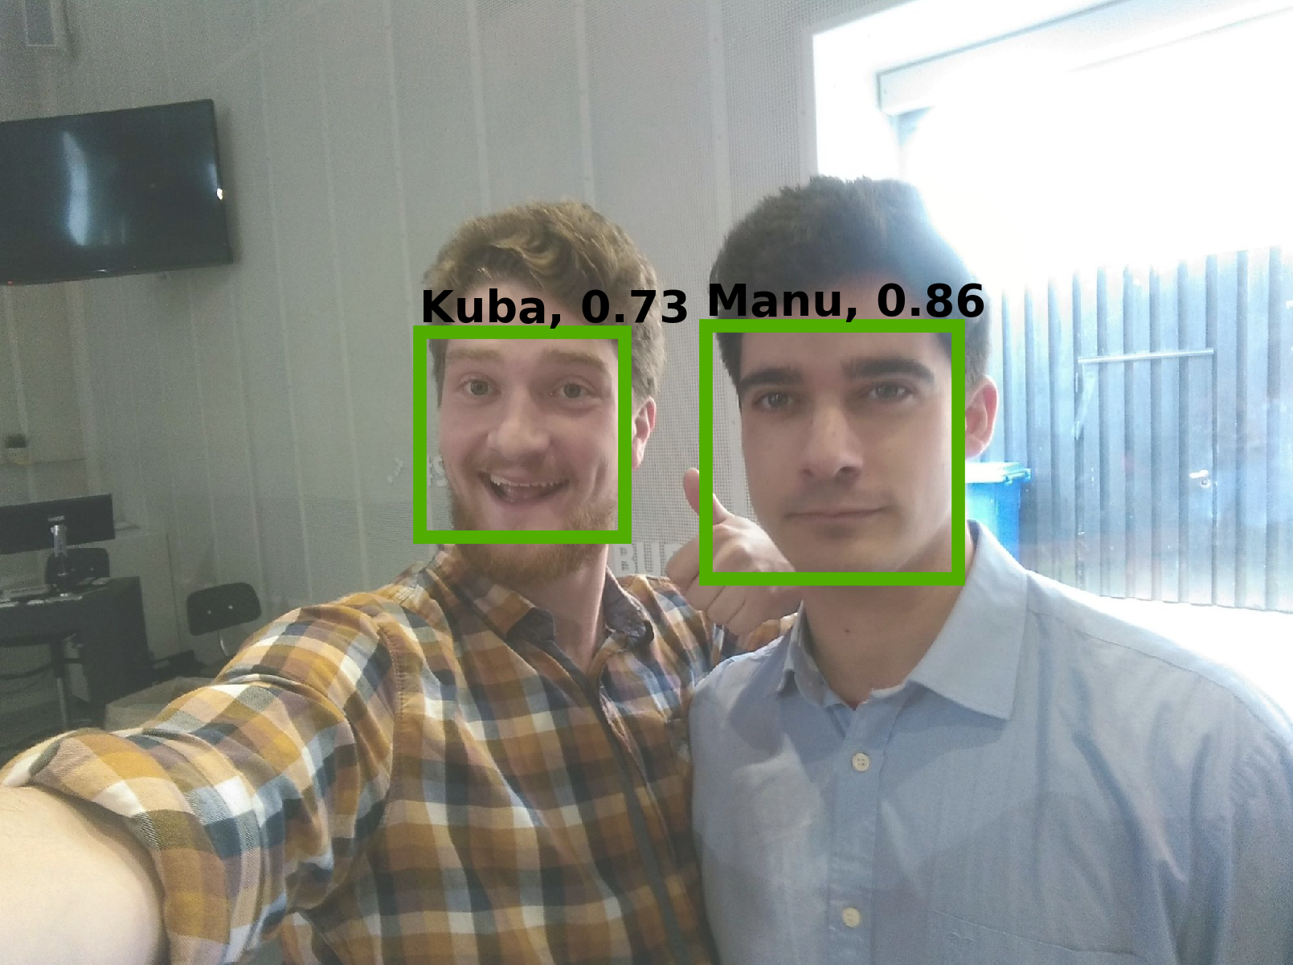
TARGET ACQUIRED!

Slide 15
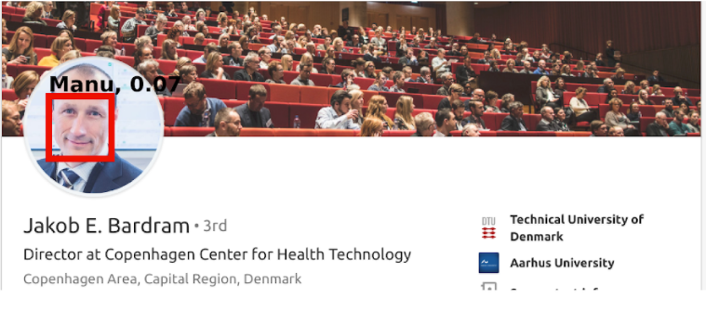
TARGET SEARCHING

Slide 16
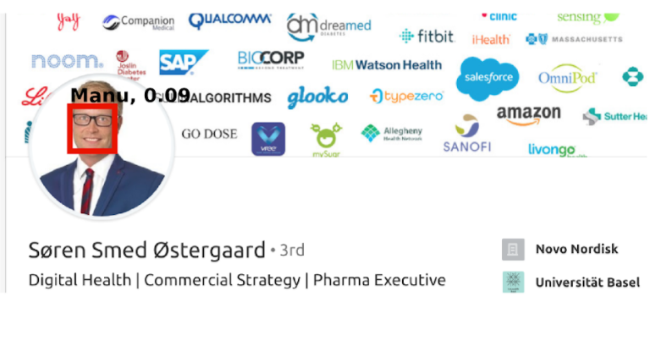
TARGET SEARCHING

Slide 17
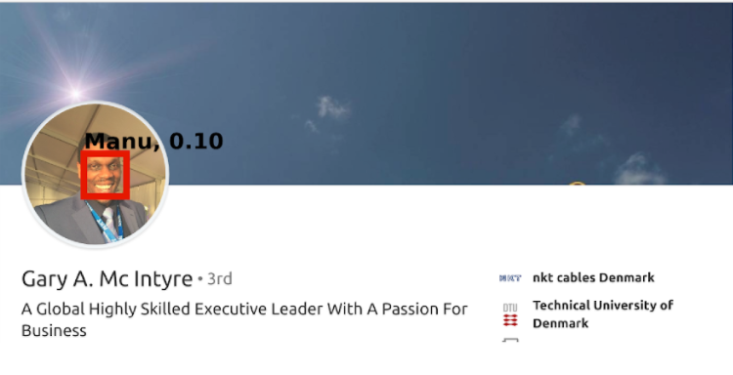
TARGET SEARCHING

Slide 18
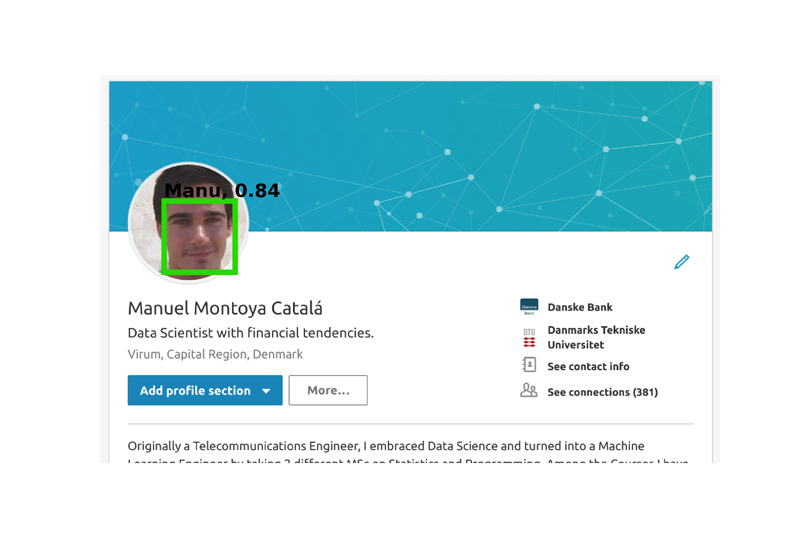
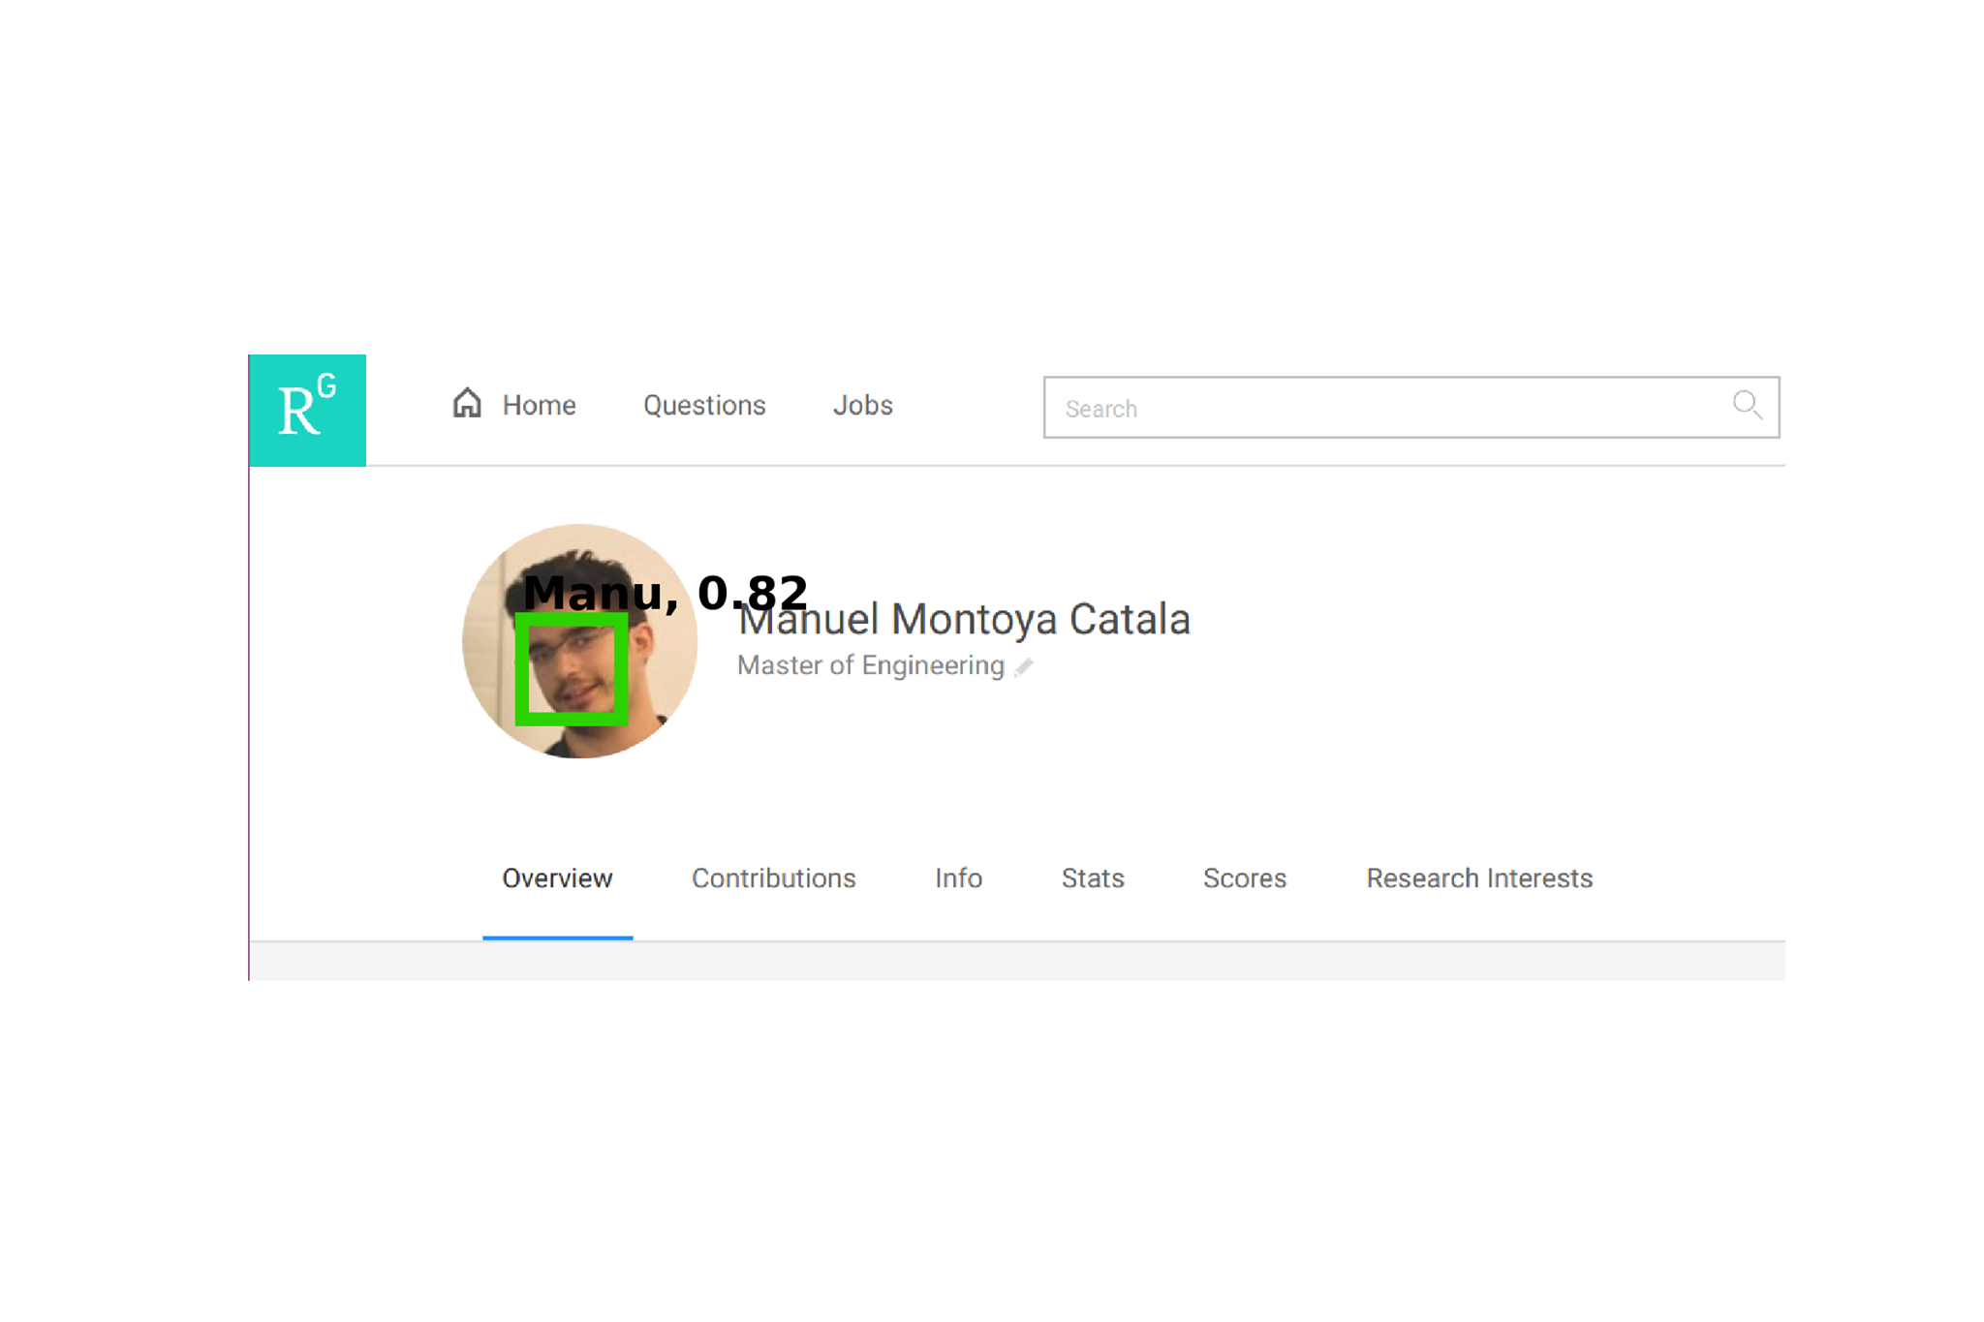
TARGET RECOGNISED!

Slide 19
BUSINESS MODEL
$$$
COMPANIES
(Novo Nordisk)
Initial Building Fee
Providing the Service
Updating the DB
WEB APP
$$$
DATA COLLECTION
CUSTOMER’S DATA
LINKEDIN
RESEARCH GATE

Slide 20
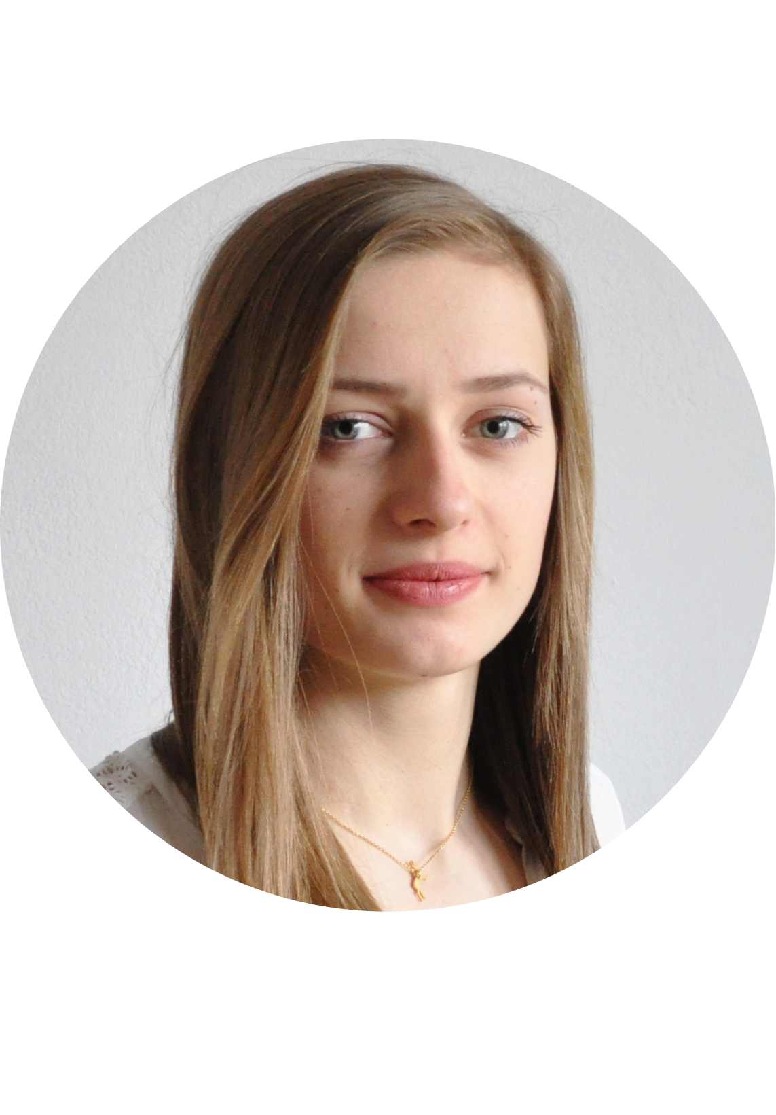
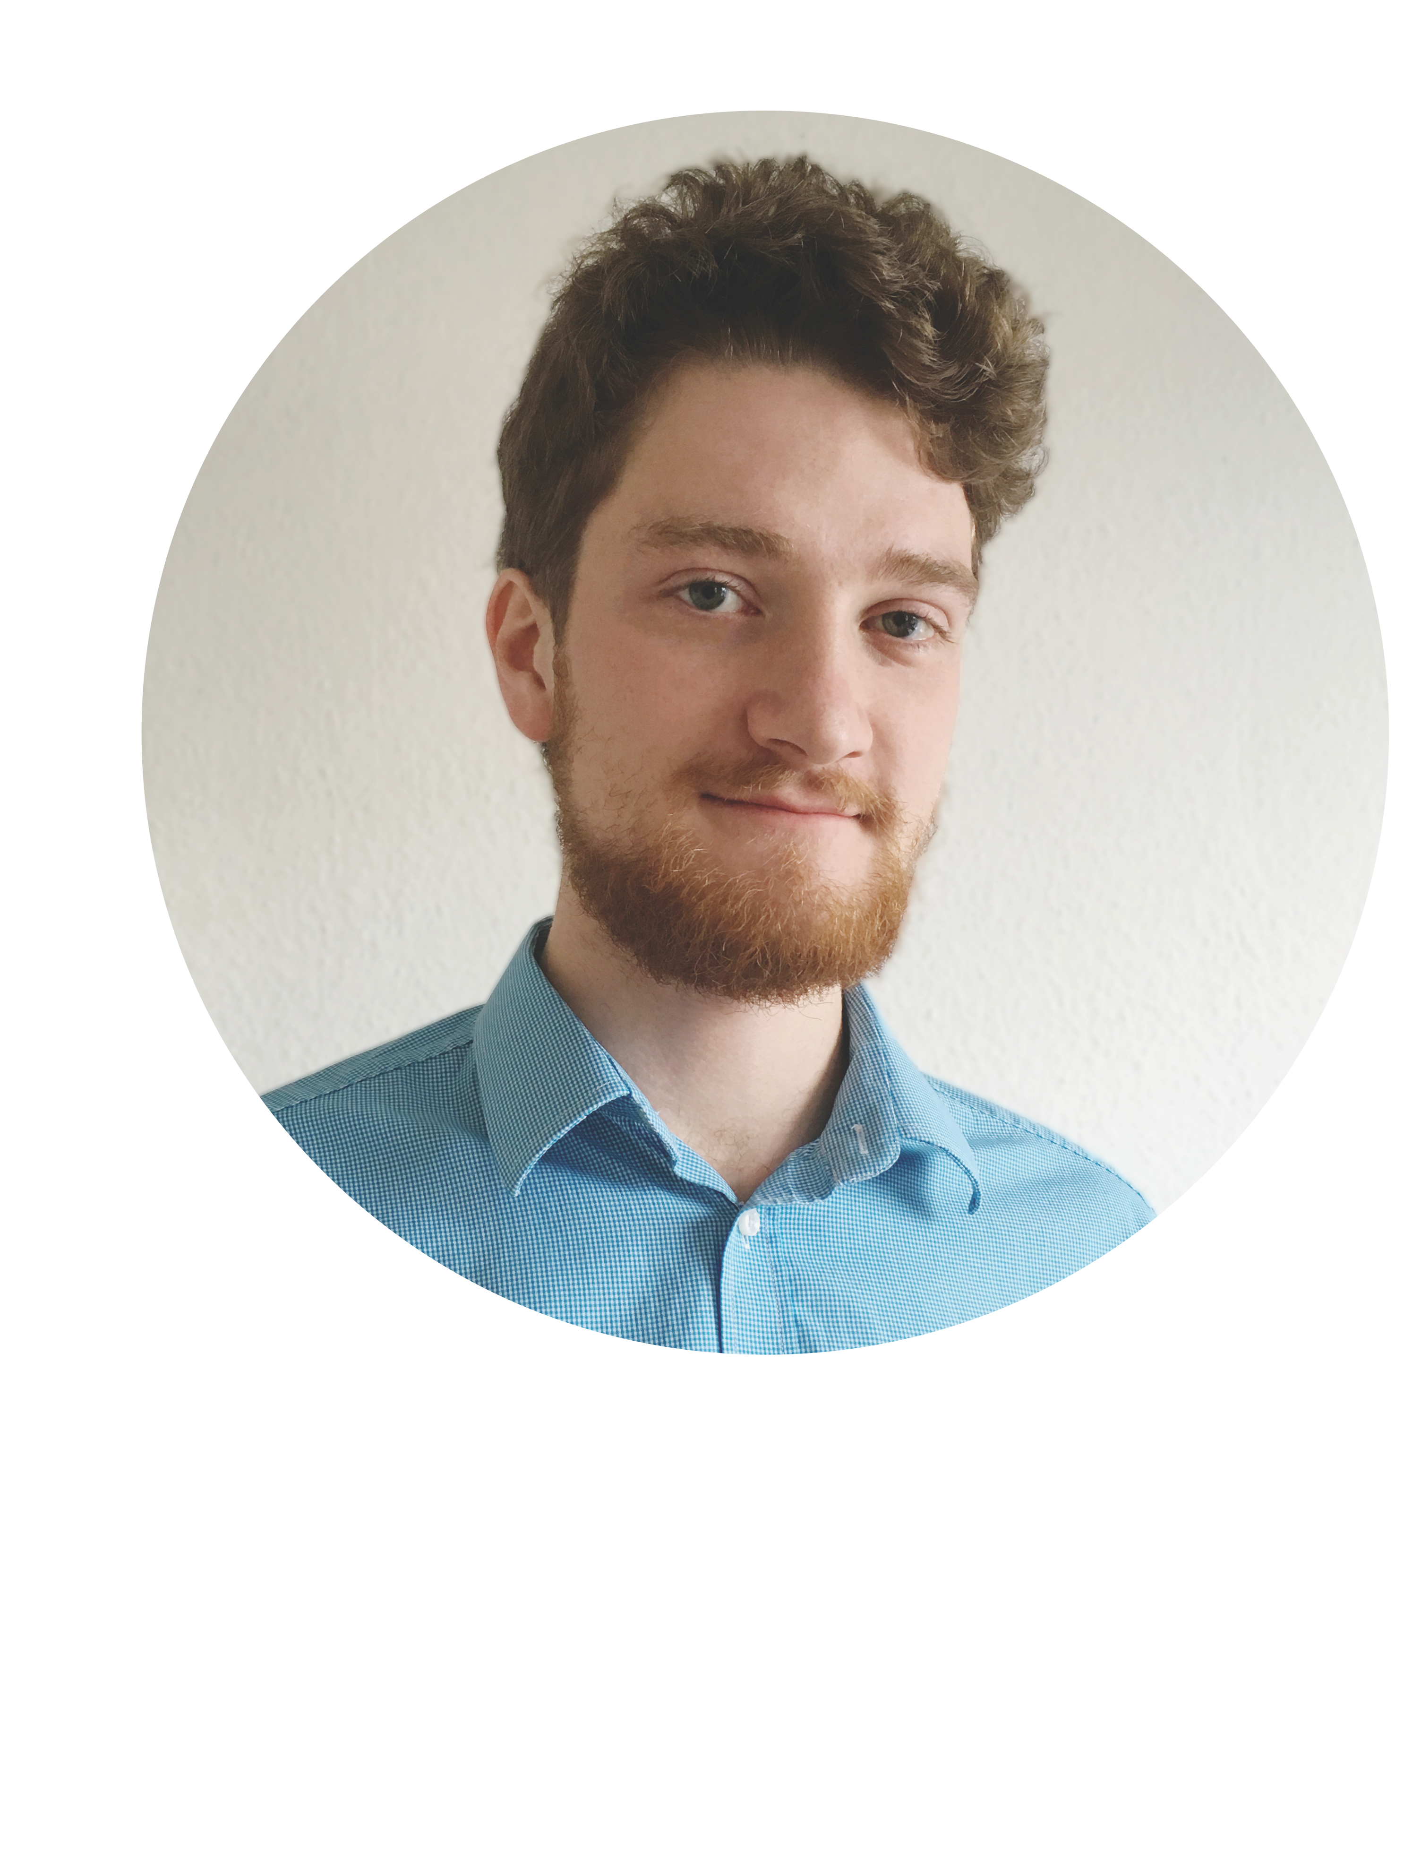
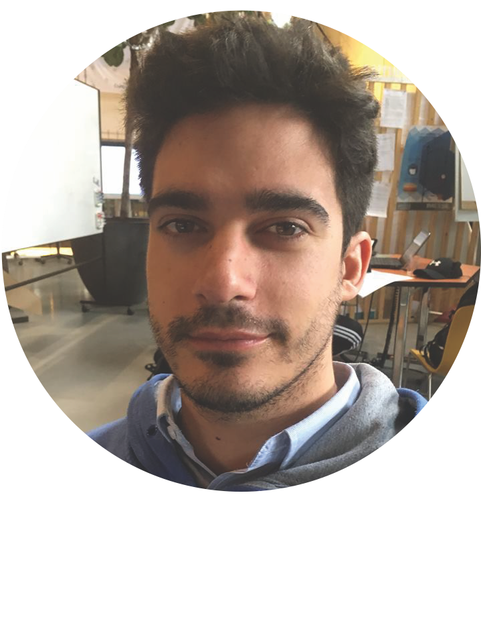
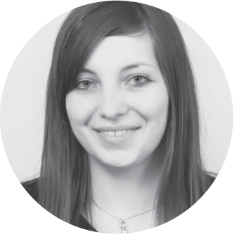
TEAM
Jakub Brzosko
Monika Ścibor
Manuel Montoya
Emanuela Falamas

Slide 21
